Slide 1
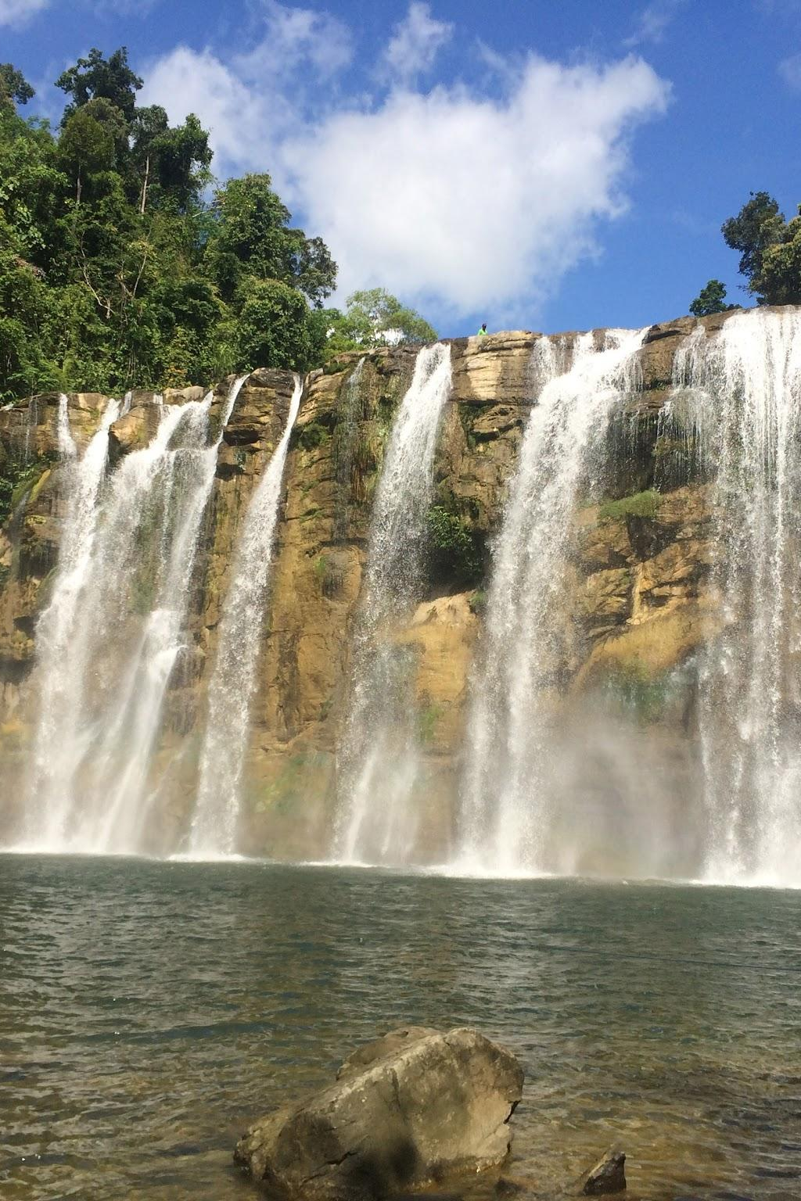
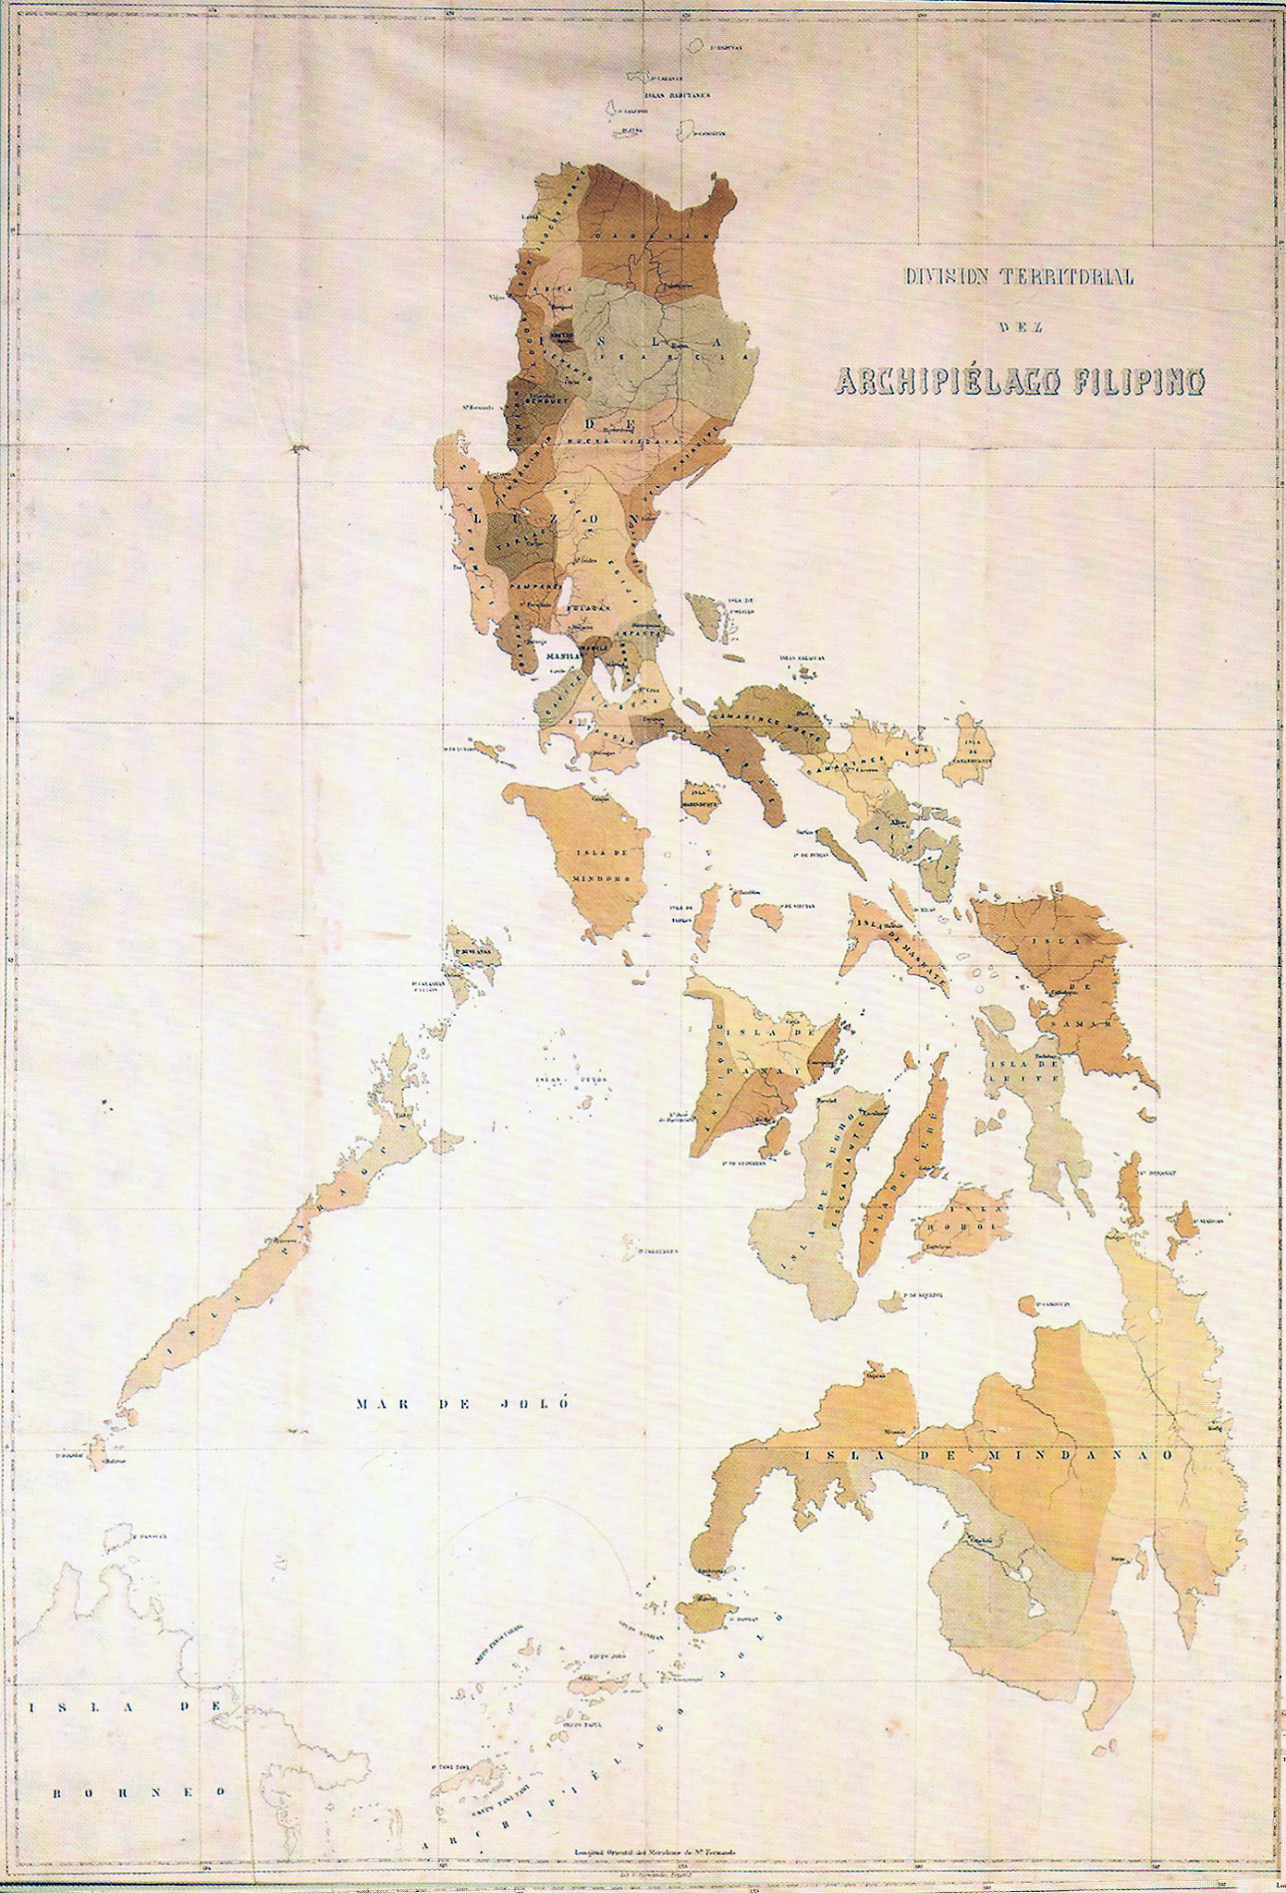

PHILIPPINES
Here is where your presentation begins

Slide 2
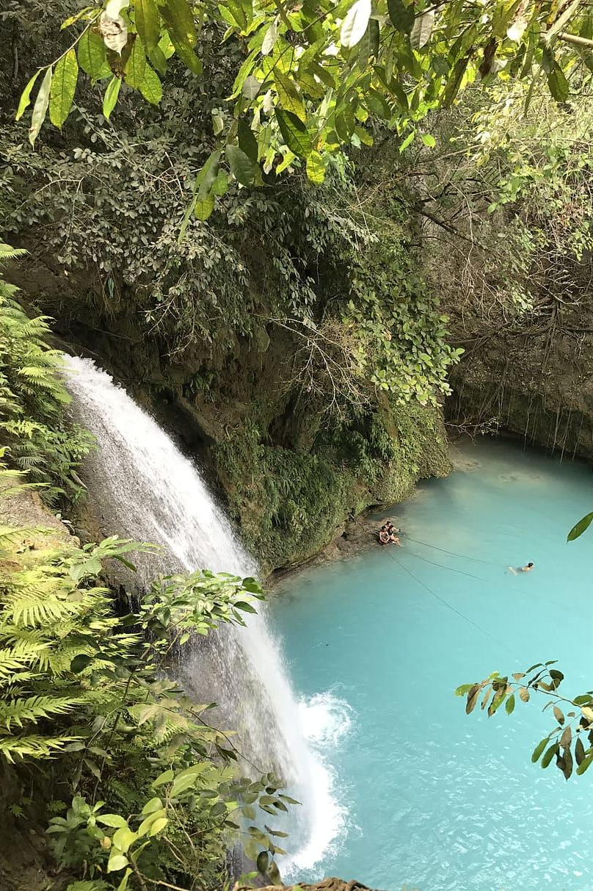

Philippines Introduction
The philippines is a group of islands in southeast asia
Where is the country located? (continent, region, climate)
What is the population and main cultural traditions?
What language is spoken and what is the government type?

Slide 4
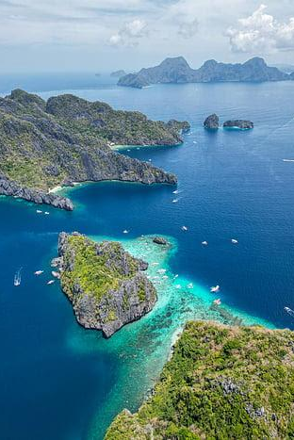
Philippines Issue
Natural Disasters & Climate Resilience is a huge problem within Philippines. Philippines is highly vulnerable to typhoons,monsoon rain, sea-level rise, and persistent flooding. The Philippines is among the countries with the greatest exposure to natural disaster risk worldwide. The philippines is located in the western Pacific Ocean( Most tropical cyclone region on earth), it’s surrounded by warm waters that are getting warmer as sea temperatures rise. It’s also located in the ring of fire and the typhoon belt, it which creates more earthquakes, typhoons, and volcanic eruptions. These are the most common disasters in the Philippines.Since the Philippines is an archipelago, it lacks a natural barriers between the islands and the sea. The role geography plays is that the philippines has tectonic island arcs, (The country is located on boundary of major tectonic plates), Narrow coastal plains, and it being lined by coral reefs, seagrass meadows, and mangrove forests.

Slide 5
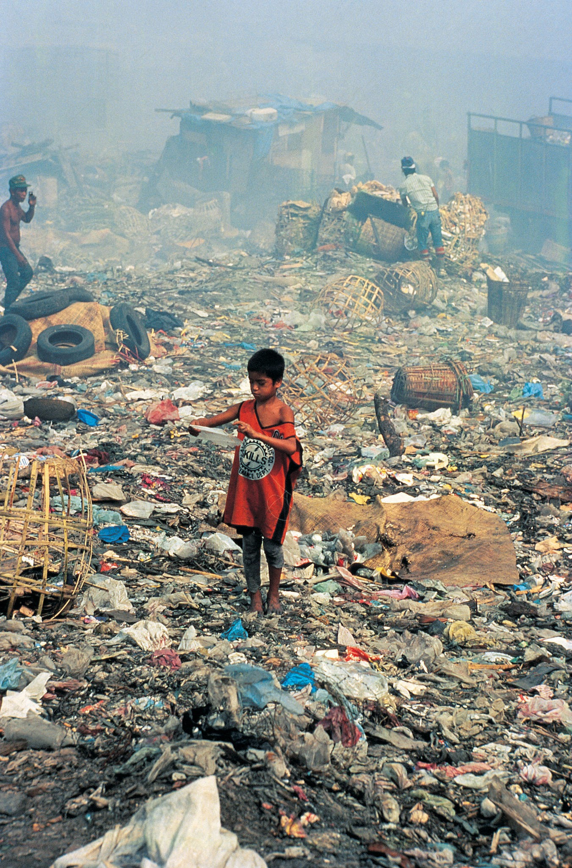


How is it affecting the world?
This issue matters globally because of how it’s affecting the environment, and the collective that lives there. The Philippines natural resources are endangered and many lives are at risk. Canadians and other people around the world should care and take climate action to help the Philippines reach a better, more sustainable future. The top causes of climate change is greenhouse emissions from energy, deforation and land use changes, agricultural practices, an increase in extreme weather events, sea-level rise, and biodiversity loss. The Philippines is the 24th highest methane-emitting country, which makes it a huge contributor to global climate change. Sea levels in the Philippines are rising more than the average global sea level rise. Philippines rises at a rate of 5.7-7 per year, while the average is 3.6mm. This causes coral reefs, coastal ecosystems and coastal communities to be at risk. The Philippines is a huge biodiversity hotspot, by it providing between 70%- 80% of the plant and animal species. So they are also endangered.

Slide 6
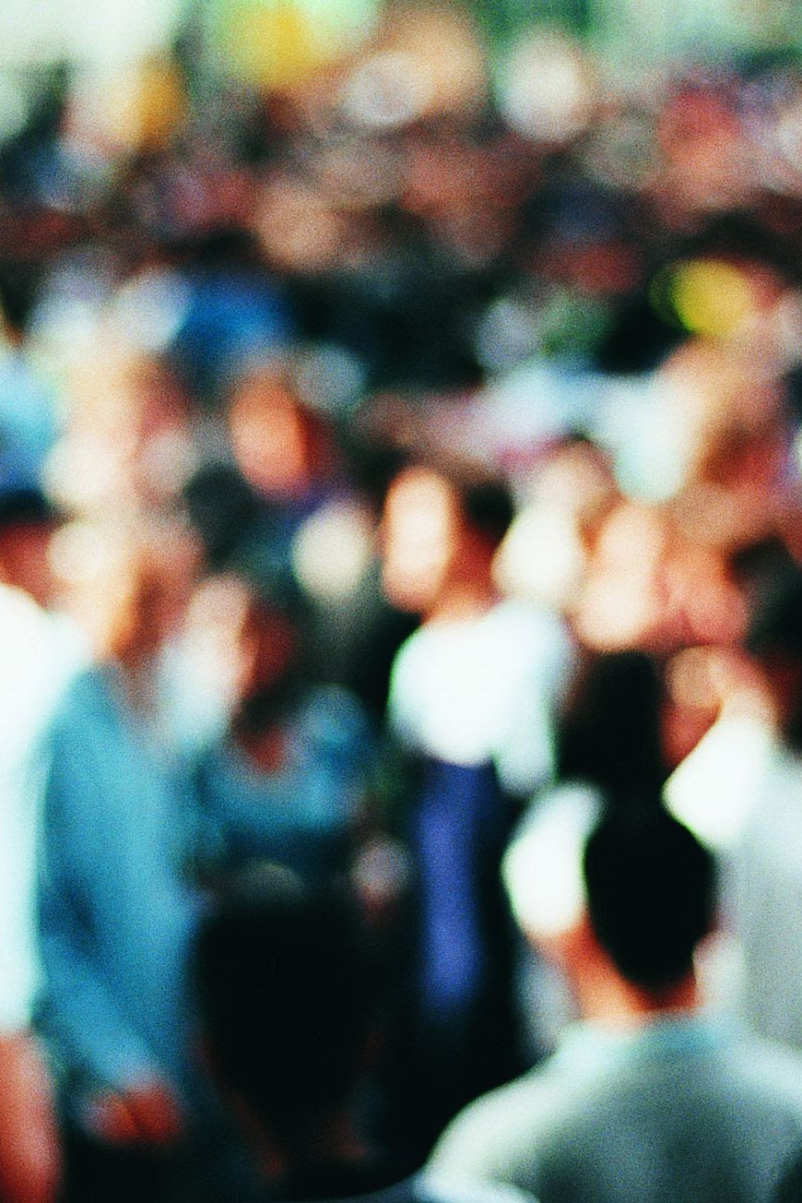
How is it affecting people?
Peoples health are getting affected. Many have experiences heat-related illnesses and deaths. The economic growth and food security is also at vulnerable. Agriculture employs 23% of the workforce. Ever since the 2024 Typhoon Enteng, it had suffered 39 Million in damage. Fisheries have also been impacted by the oceans warming. The catch potential has now gone down by 24%. Tourism has also gone down from all of the natural disasters, which has caused the country's gdp to go down. People in the country are also getting blamed for these floods. People say because of factors like clogging waterways, those who live along riverbanks, and much more, the floods are caused by the citizens lack of discipline. In reality, it’s how politicians and contractors stole money from fake flood control projects. This resulted in prompting a public protest. If some people survive these disasters, they could also deal with much stress, and be in bad condition.

Slide 7
Action
The Philippines has planned out and tried to reduce the effects of natural disasters by giving better and improved warning systems for storms and floods. Some evacuation centers have been built, training rescue teams for people, and having drills to prepare for disaster. The government has also created laws and plans for managing disasters, upgraded flood control projects, built stronger infrastructure, relocated people from dangerous areas, restored forests and mangroves, create a emergency bill to buy food and protect their home before disasters, give help/aid and support to communities affected by disasters. This helps protect people and reduce damage when disasters happen. Studies show that these actions showed improvement in household food security. The evacuations have been successful, The amount of deaths has been deaths amount, and the drills have been effective.

Slide 8
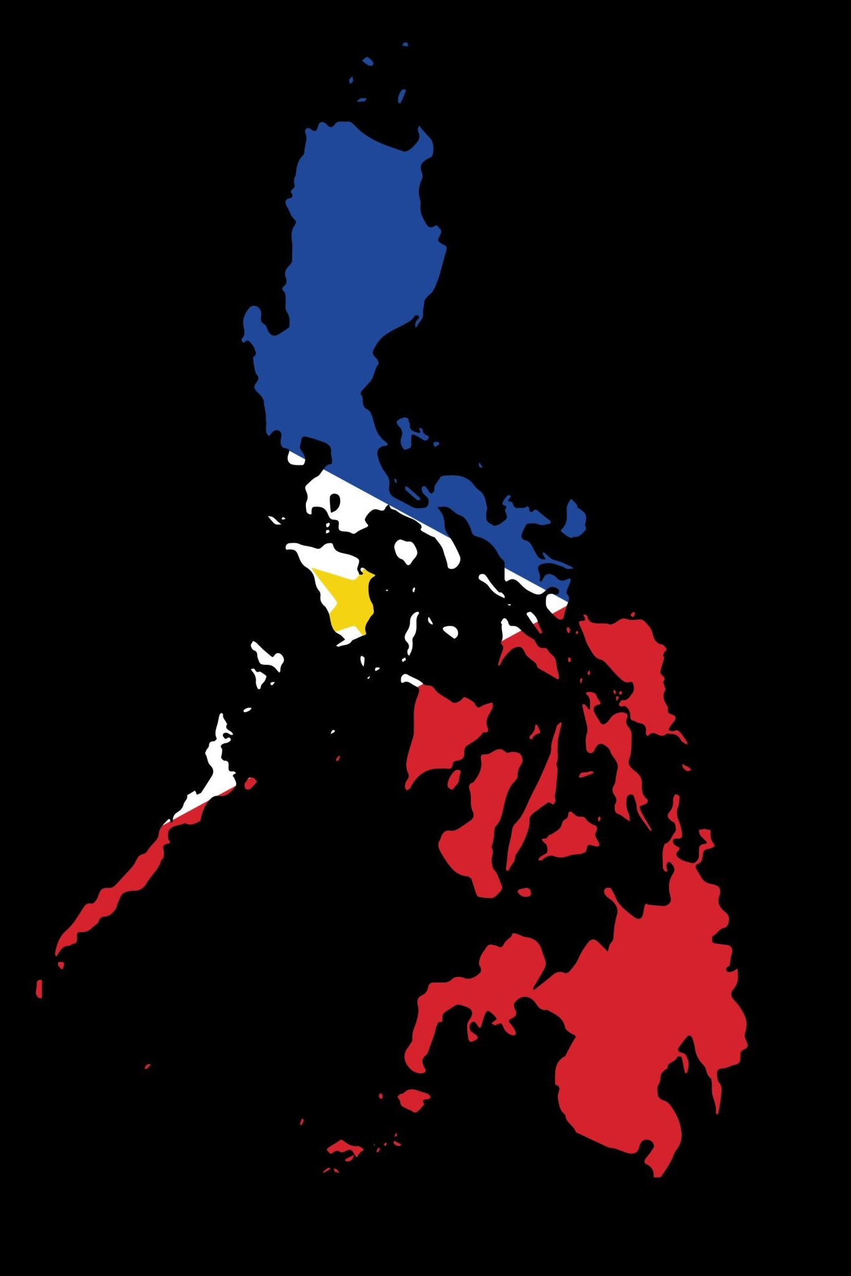
Programs
Projects such as Declaration of State of Imminent Disaster Act (RA 12287) is a emergency cash transfer that is given to protect families ahead of a crisis. Another law is DIsaster risk reduction and management act (DRRM) which tries to plan ahead and prepare before disasters happen, rather than responding after one. It’s a law which transforms the Philippines’ disaster management system from disaster relief and response towards disaster risk reduction (DRR). Multi-Hazard impact-based Forecasting, which sets up early warning systems so communities are safer before disasters hit. The Philippine Atmospheric, Geophysical and Astronomical Services Administration (DOST-PAGASA) is a service which delivers weather related information, products and services to help and develop communities resilient to these natural disasters. The National Disaster Risk Reduction and Management Council (NDRRMC) Is a national act that prepares for disasters, has protocols to be prepared, and tries to reduce community vulnerabilities .Its the Philippines primary disaster management. They have also launched the National Adaptation plan which is targeted to help countries with climate change. Disaster risk management (DRM), and Department of Public works and Highways (DPWH) are trying to make building safer. There have been meetings with 100 technical experts, government officials representatives and more.. This is so builds are more stable.

Slide 9
Consequences
Short term effects:
-Loss of lives and injuries.
-evicting families and communities.
-a pause in education due to damaged schools.
-Increased health risks from contaminated water and overcrowded evacuation centers.
-Damage to homes, businesses, roads, and bridges.
-Loss of income for farmers, fishers, and workers.
-Increased government spending on emergency relief and recovery.
-Soil erosion and landslides.
-Destruction of forests, coral reefs, and coastal ecosystems.
-Water contamination from flooding
Long term effects:
-Long-term displacement and migration.
-Mental health impact on people
-Increased poverty and inequality.
-Slower economic growth in some areas.
-Farms growing less food than before.
-High reconstruction costs.
-Loss of biodiversity.
-The coastal breaking down which causes more danger to future disasters
-Changes in ecosystems and natural resources.

Slide 10
Consequences
Who Benefits? Who suffers?
Before the land is destroyed corporations and property developers make lots of money by building big beachfront hotels, fancy houses, and ports for large ships. Before the land is gone, they sell it for money. Tourist businesses also make money from travelers who come to visit. But this causes big problems for the regular people who actually live there. Local families lose their homes when the land washes into the sea, and local fishers lose their jobs because the fish have nowhere left to live.They need to pay to fix the damage and the future generations might start to live on bad land.
Unintended Consequences:
None of these disasters are intended. Beaches and cliffs start to crumble into the sea from erosion. When coastal trees and reefs are cut down, that means the barriers are gonna stop big storm waves from rushing much farther in land and cause worse flooding. This also ruins the areas where fish live and lay eggs, so the fish eggs are destroyed. The salty ocean water pushes into the ground, which ruins the clean freshwater that local people need for drinking and farming.

Slide 11
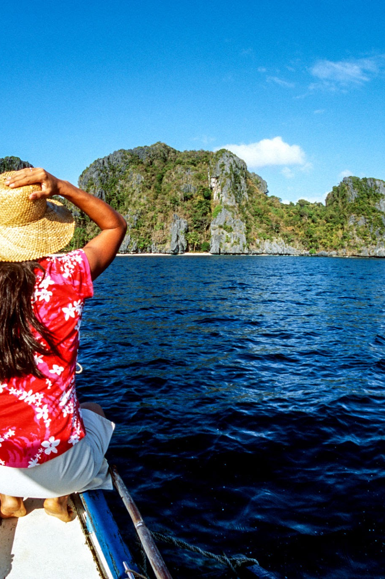

Canada Comparison
Do you know what helps you make your point in a clear way?
Lists like this one:
They’re simple
You can organize your ideas clearly
You’ll never forget to buy milk!
And the most important thing: the audience won’t miss the point of your presentation

Slide 12
Reflection
Biodiversity conservation and ecosystem preservation
Mercury is the closest planet to the Sun and the smallest one in the Solar System. This planet’s name has nothing to do with the liquid metal, since Mercury was named after the Roman messenger god
Recreational and educational opportunities
Jupiter is a gas giant and the biggest planet in the Solar System. It’s the fourth-brightest object in the night sky. It was named after the Roman god of the skies and lightning

